Slide 1
Chapter 15 : Concurrency Control

Slide 2
Outline
Lock-Based Protocols
Timestamp-Based Protocols
Validation-Based Protocols
Multiple Granularity
Multiversion Schemes
Insert and Delete Operations
Concurrency in Index Structures

Slide 3
concurrency
What is concurrency?
Concurrency in terms of databases means allowing multiple users to access the data contained within a database at the same time.
If concurrent access is not managed by the Database Management System (DBMS) another problems can occur when various transactions interleave,
resulting in an inconsistent database.
Concurrency is achieved by the DBMS, which interleaves actions (reads/writes of DB objects) of various transactions. Each transaction must leave the database in a consistent state if the DB is consistent when the transaction begins.

Slide 4
concurrency
reasons for allowing concurrency
1. Improved throughput and resource utilization.
(THROUGHPUT = Number of Transactions executed per unit of time.)
The CPU and the Disk can operate in parallel. When a Transaction
Read/Write the Disk another Transaction can be running in the CPU.
The CPU and Disk utilization also increases.
2. Reduced waiting time.
In a serial processing a short Transaction may have to wait for a long transaction to complete. Concurrent execution reduces the average response time; the average time for a Transaction to be completed.

Slide 5
concurrency control
What is concurrency control?
Concurrency control is needed to handle problems that can occur when transactions execute concurrently. The following are the concurrency issues:-
Lost Update: an update to an object by some transaction is overwritten by another interleaved transaction without knowledge of the initial update.
Incorrect Analysis Problem / The problem of dirty read occurs when a transaction reads several values from the data base while another transactions are updating the values.
Unrepeatable read
Uncommitted Dependency: The Temporary Update
updates a database item and then the transaction fails for some reason as dirty read or unrepeatable data. a transaction reads an object updated by another transaction that later falls.
Inconsistent Analysis: The Incorrect Summary Problem. a transaction calculating an aggregate function uses some but not all updated objects of another transaction

Slide 6
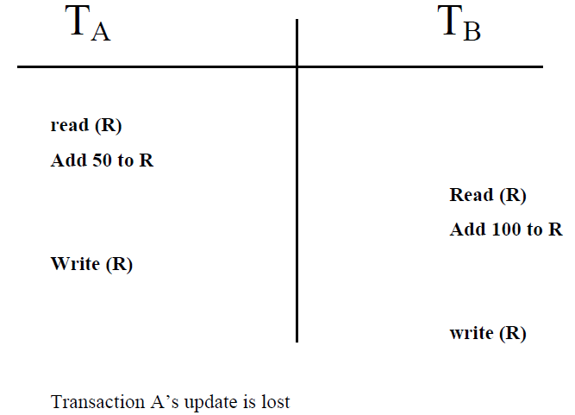
Lost Update:

Slide 7
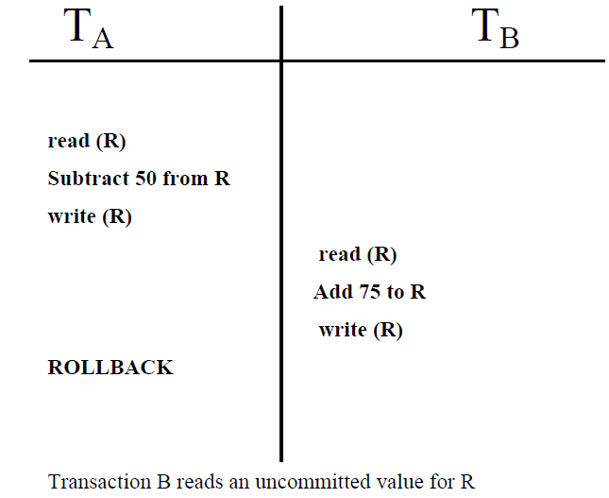
Uncommitted Dependency

Slide 8
Concurrency control techniques
Using concurrency control protocols (sets of rules) that guarantee serializability.
Two-phase locking protocols
Employ the technique of locking data items to prevent multiple transactions from accessing the items concurrently
Tmestamps
A timestamp is a unique identifier for each transaction, generated by the system. Timestamps values are generated in the same order as the transaction start times
Multiversion
Concurrency control protocols that use multiple versions of a data item. One multiversion protocol extends timestamp order to multiversion timestamp ordering and another extends two-phase locking

Slide 9
Concurrency control techniques
Lock technique
A lock is a variable associated with a data item that describes the status of the item
A lock is a mechanism to control concurrent access to a data item
Binary Locks. A binary lock can have two states or values: locked and unlocked (or1 and 0, for simplicity). A distinct lock is associated with each database item X. If the
value of the lock on X is 1, item X cannot be accessed by a database operation that
requests the item. If the value of the lock on X is 0, the item can be accessed when
requested, and the lock value is changed to 1.We refer to the current value (or state)
of the lock associated with item X as lock(X).
Two operations, lock_item and unlock_item, are used with binary locking.A transaction
requests access to an item X by first issuing a lock_item(X) operation. If LOCK(X) =
1, the transaction is forced to wait. If LOCK(X) = 0, it is set to 1 (the transaction locks
the item) and the transaction is allowed to access item X. When the transaction is
through using the item, it issues an unlock_item(X) operation, which sets LOCK(X)
back to 0 (unlocks the item) so that X may be accessed by other transactions

Slide 10
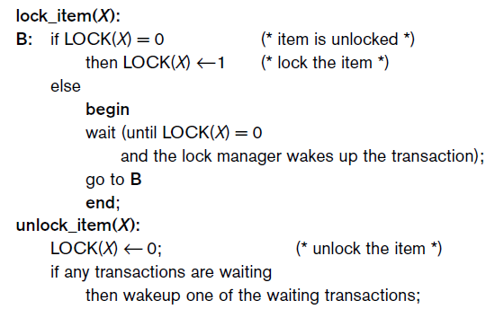
Binary lock

Slide 11
Binary lock
If the simple binary locking scheme described here is used, every transaction must
obey the following rules:
1. A transaction T must issue the operation lock_item(X) before any
read_item(X) or write_item(X) operations are performed in T.
2. A transaction Tmust issue the operation unlock_item(X) after all read_item(X)
and write_item(X) operations are completed in T.
3. A transaction T will not issue a lock_item(X) operation if it already holds the
lock on item X.1
4. A transaction T will not issue an unlock_item(X) operation unless it already
holds the lock on item X.
معامله اصدار

Slide 12
Lock-Based Protocols
because at most, one transaction can hold a lock on a given item.We should allow several transactions to access the same item X if they all access X for reading purposes only.This is because read operations on the same item by different transactions are not conflicting
There are three locking operations: read_lock(X), write_lock(X), and unlock(X).
Now has three possible states: read-locked(share-locked), write-locked(exclusive-locked), or unlocked.
Data items can be locked in two modes :
1. exclusive (X) mode.
2. shared (S) mode. Data item can only be read.

Slide 13
Lock-Based Protocols (Cont.)
Lock-compatibility matrix
lock table. Each record in the lock table will have four fields: <Data_item_name,LOCK, No_of_reads, Locking_transaction(s)>.
A transaction may be granted a lock on an item if the requested lock is compatible with locks already held on the item by other transactions
Any number of transactions can hold shared locks on an item,
But if any transaction holds an exclusive on the item no other transaction may hold any lock on the item.
If a lock cannot be granted, the requesting transaction is made to wait till all incompatible locks held by other transactions have been released. The lock is then granted.

Slide 14
Lock-Based Protocols (Cont.)
A locking protocol is a set of rules followed by all transactions while requesting and releasing locks. Locking protocols restrict the set of possible schedules.

Slide 15
The Two-Phase Locking Protocol
This protocol ensures conflict-serializable schedules.
Phase 1: Growing Phase
Transaction may obtain locks
Transaction may not release locks
Phase 2: Shrinking Phase
Transaction may release locks
Transaction may not obtain locks
The protocol assures serializability. It can be proved that the transactions can be serialized in the order of their lock points (i.e., the point where a transaction acquired its final lock).

Slide 16
The Two-Phase Locking Protocol
When we use the shared/exclusive locking scheme, the system must enforce the following
rules:
1. A transaction T must the operation read_lock(X) or write_lock(X) before
any read_item(X) operation is performed in T.
2. A transaction T must issue the operation write_lock(X) before any
write_item(X) operation is performed in T.
3. A transaction T must issue the operation unlock(X) after all read_item(X) and
write_item(X) operations are completed in T.3
4. A transaction T will not issue a read_lock(X) operation if it already holds a
read (shared) lock or a write (exclusive) lock on item X. This rule may be
relaxed,
5. A transaction T will not issue a write_lock(X) operation if it already holds a
read (shared) lock or write (exclusive) lock on item X. This rule may also be
relaxed,
6. A transaction T will not issue an unlock(X) operation unless it already holds
a read (shared) lock or a write (exclusive) lock on item X.

Slide 17
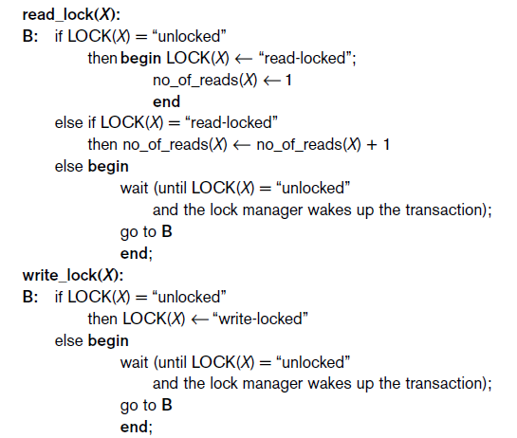
The Two-Phase Locking Protocol

Slide 18
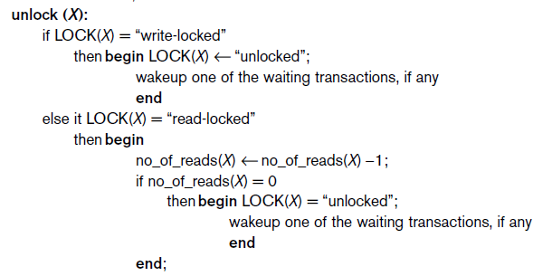
The Two-Phase Locking Protocol

Slide 19
Lock Conversionsتحويل الأقفال.
Conversion of Locks. Sometimes it is desirable to relax conditions 4 and 5 in the
preceding list in order to allow lock conversion; that is, a transaction that already
holds a lock on item X is allowed under certain conditions to convert the lock from
one locked state to another. For example, it is possible for a transaction T to issue a
read_lock(X) and then later to upgrade the lock by issuing a write_lock(X) operation.
If T is the only transaction holding a read lock on X at the time it issues the write_lock(X) operation, the lock can be upgraded; otherwise, the transaction must wait.
It is also possible for a transaction T to issue a write_lock(X) and then later to downgrade the lock by issuing a read_lock(X) operation. When upgrading and downgrading of locks is used, the lock table must include transaction identifiers in the record structure for each lock
4. A transaction T will not issue a read_lock(X) operation if it already holds a
read (shared) lock or a write (exclusive) lock on item X. This rule may be
relaxed,
5. A transaction T will not issue a write_lock(X) operation if it already holds a
read (shared) lock or write (exclusive) lock on item X. This rule may also be
relaxed,

Slide 20
Deadlocks
In a multi-process system, deadlock is an unwanted situation that arises in a shared resource
environment, where a process indefinitely waits for a resource that is held by another process.
For example, assume a set of transactions {T0, T1, T2, ...,Tn}. T0 needs a resource X to complete its task. Resource X is held by T1, and T1 is waiting for a resource Y, which is held by T2. T2 is waiting for resource Z, which is held by T0. Thus, all the processes wait for each other to release resources.
In this situation, none of the processes can finish their task. This situation is known as a deadlock.

Slide 21
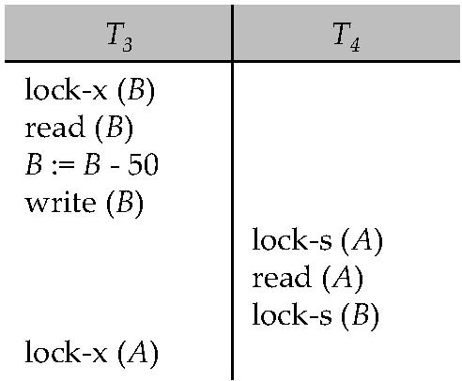
Deadlocks
Consider the partial schedule
Neither T₃ nor T₄ can make progress — executing lock-S(B) causes T₄ to wait for T₃ to release its lock on B, while executing lock-X(A) causes T₃ to wait for T₄ to release its lock on A.
Such a situation is called a deadlock.
To handle a deadlock one of T₃ or T₄ must be rolled back and its locks released.

Slide 22
Deadlocks (Cont.)
Two-phase locking does not ensure freedom from deadlocks.
In addition to deadlocks, there is a possibility of starvation.
An example is maximum throughput scheduling. Starvation is similar to deadlock in that it causes a process to freeze. Two or more processes become deadlocked when each of them is doing nothing while waiting for a resource occupied by another program in the same set.
Concurrency control manager can be designed to prevent starvation.

Slide 23
Deadlocks (Cont.)
The potential for deadlock exists in most locking protocols. Deadlocks are a necessary evil.
When a deadlock occurs there is a possibility of cascading roll-backs.
Cascading roll-back is possible under two-phase locking. To avoid this, follow a modified protocol called strict two-phase locking -- a transaction must hold all its exclusive locks till it commits/aborts.
A cascading rollback occurs in database systems when a transaction (T1) causes a failure and a rollback must be performed. Other transactions dependent on T1's actions must also be rollbacked due to T1's failure, thus causing a cascading effect. That is, one transaction's failure causes many to fail.
Rigorous two-phase locking is even stricter. Here, all locks are held till commit/abort. In this protocol transactions can be serialized in the order in which they commit.

Slide 24
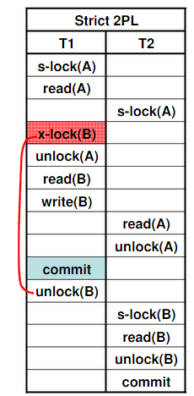
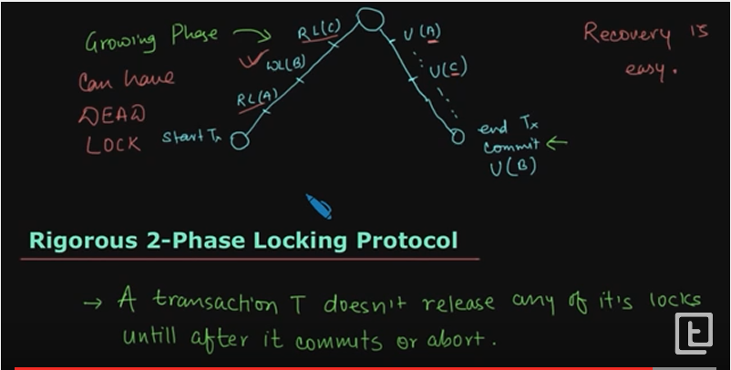

Slide 25
Implementation of Locking
A lock manager can be implemented as a separate process to which transactions send lock and unlock requests
The lock manager replies to a lock request by sending a lock grant messages (or a message asking the transaction to roll back, in case of a deadlock)
The requesting transaction waits until its request is answered
The lock manager maintains a data-structure called a lock table to record granted locks and pending requests
The lock table is usually implemented as an in-memory hash table indexed on the name of the data item being locked

Slide 26
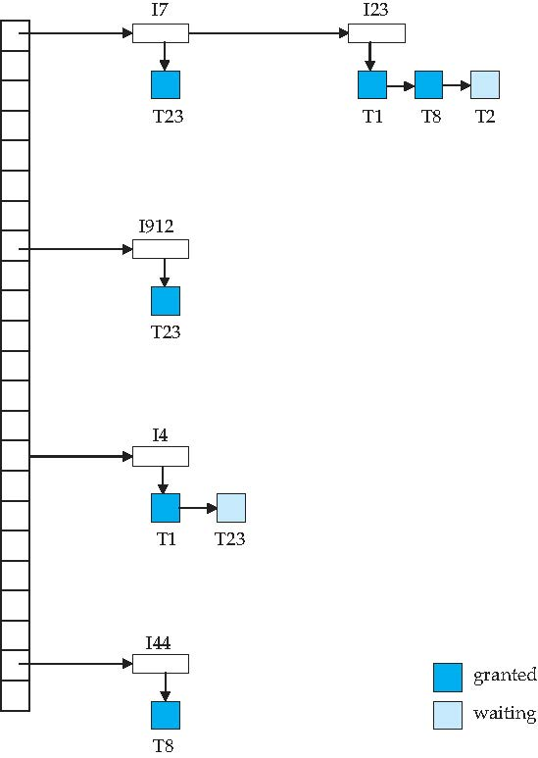
Lock Table
Dark blue rectangles indicate granted locks; light blue indicate waiting requests
Lock table also records the type of lock granted or requested
New request is added to the end of the queue of requests for the data item, and granted if it is compatible with all earlier locks
Unlock requests result in the request being deleted, and later requests are checked to see if they can now be granted
If transaction aborts, all waiting or granted requests of the transaction are deleted
lock manager may keep a list of locks held by each transaction, to implement this efficiently

Slide 27
Deadlock Handling
System is deadlocked if there is a set of transactions such that every transaction in the set is waiting for another transaction in the set.
Deadlock prevention protocols ensure that the system will never enter into a deadlock state. Some prevention strategies :
Require that each transaction locks all its data items before it begins execution (predeclaration).

Slide 28
More Deadlock Prevention Strategies
Following schemes use transaction timestamps for the sake of deadlock prevention alone.
wait-die scheme — non-preemptive
older transaction may wait for younger one to release data item. (older means smaller timestamp) Younger transactions never Younger transactions never wait for older ones; they are rolled back instead.
a transaction may die several times before acquiring needed data item
wound-wait scheme — preemptive
older transaction wounds (forces rollback) of younger transaction instead of waiting for it. Younger transactions may wait for older ones.
may be fewer rollbacks than wait-die scheme.

Slide 29
More Deadlock Prevention Strategies
■ Wait-die. If TS(Ti) < TS(Tj), then (Ti older than Tj) Ti is allowed to wait;
otherwise (Ti younger than Tj) abort Ti (Ti dies) and restart it later with the
same timestamp.
■ Wound-wait. If TS(Ti) < TS(Tj), then (Ti older than Tj) abort Tj (Ti wounds
Tj) and restart it later with the same timestamp; otherwise (Ti younger than
Tj) Ti is allowed to wait.

Slide 30
Deadlock prevention (Cont.)
Both in wait-die and in wound-wait schemes, a rolled back transactions is restarted with its original timestamp. Older transactions thus have precedence over newer ones, and starvation is hence avoided.
Timeout-Based Schemes:
a transaction waits for a lock only for a specified amount of time. If the lock has not been granted within that time, the transaction is rolled back and restarted,
Thus, deadlocks are not possible
simple to implement; but starvation is possible. Also difficult to determine good value of the timeout interval.

Slide 31
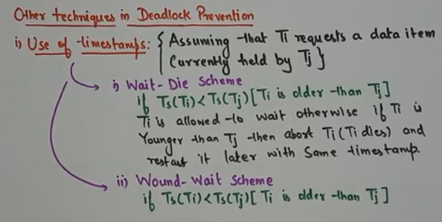

Slide 32
Deadlock Detection
Deadlocks can be described as a wait-for graph, which consists of a pair G = (V,E),
V is a set of vertices (all the transactions in the system)
E is a set of edges; each element is an ordered pair T_{i} →T_{j}.
If T_{i} → T_{j} is in E, then there is a directed edge from T_{i} to T_{j}, implying that T_{i} is waiting for T_{j} to release a data item.
When T_{i} requests a data item currently being held by T_{j}, then the edge T_{i} → T_{j} is inserted in the wait-for graph. This edge is removed only when T_{j} is no longer holding a data item needed by T_{i}.
The system is in a deadlock state if and only if the wait-for graph has a cycle. Must invoke a deadlock-detection algorithm periodically to look for cycles.

Slide 33
Deadlock Detection (Cont.)
Wait-for graph without a cycle
Wait-for graph with a cycle

Slide 34
Deadlock Recovery
When deadlock is detected :
Some transaction will have to rolled back (made a victim) to break deadlock. Select that transaction as victim that will incur minimum cost.
Rollback -- determine how far to roll back transaction
Total rollback: Abort the transaction and then restart it.
More effective to roll back transaction only as far as necessary to break deadlock.
Starvation happens if same transaction is always chosen as victim. Include the number of rollbacks in the cost factor to avoid starvation

Slide 35
Timestamp-Based Protocols
Each transaction is issued a timestamp when it enters the system. If an old transaction T_{i} has time-stamp TS(T_{i}), a new transaction T_{j} is assigned time-stamp TS(T_{j}) such that TS(T_{i}) <TS(T_{j}).
The protocol manages concurrent execution such that the time-stamps determine the serializability order.
In order to assure such behavior, the protocol maintains for each data Q two timestamp values:
W-timestamp(Q) is the largest time-stamp of any transaction that executed write(Q) successfully.
R-timestamp(Q) is the largest time-stamp of any transaction that executed read(Q) successfully.

Slide 36
Timestamp-Based Protocols (Cont.)
The timestamp ordering protocol ensures that any conflicting read and write operations are executed in timestamp order.
Suppose a transaction T_{i} issues a read(Q)
If TS(T_{i}) < W-timestamp(Q), then T_{i} needs to read a value of Q that was already overwritten.
Hence, the read operation is rejected, and T_{i} is rolled back.
If TS(T_{i}) > W-timestamp(Q), then the read operation is executed, and R-timestamp(Q) is set to max(R-timestamp(Q), TS(T_{i})).

Slide 37
Timestamp-Based Protocols (Cont.)
Suppose that transaction T_{i} issues write(Q).
If TS(T_{i}) < R-timestamp(Q), then the value of Q that T_{i} is producing was needed previously, and the system assumed that that value would never be produced.
Hence, the write operation is rejected, and T_{i} is rolled back.
If TS(T_{i}) < W-timestamp(Q), then T_{i} is attempting to write an obsolete value of Q.
Hence, this write operation is rejected, and T_{i} is rolled back.
Otherwise, the write operation is executed, and W-timestamp(Q) is set to TS(T_{i}).

Slide 38
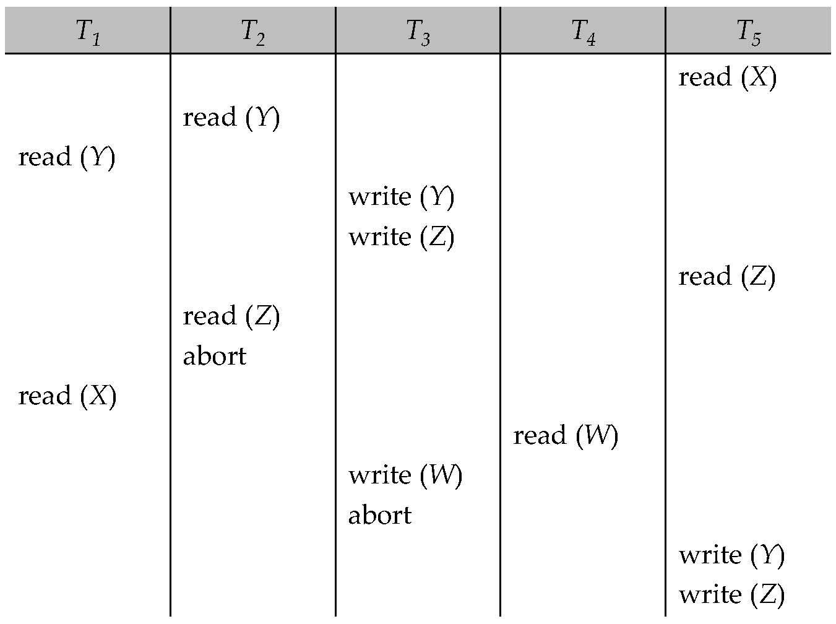
Example Use of the Protocol
A partial schedule for several data items for transactions with
timestamps 1, 2, 3, 4, 5

Slide 39
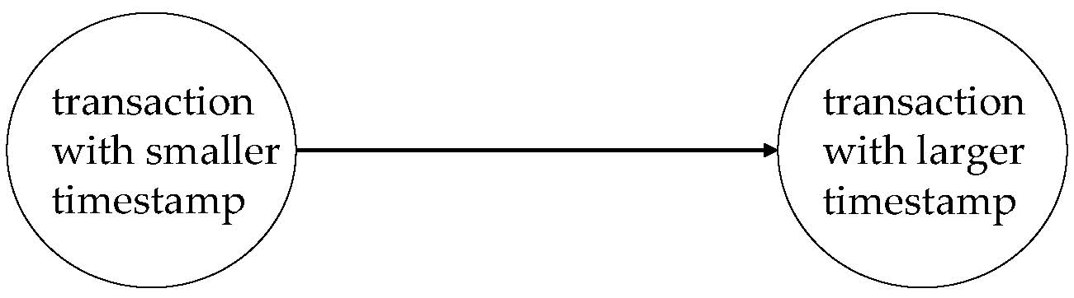
Correctness of Timestamp-Ordering Protocol
The timestamp-ordering protocol guarantees serializability since all the arcs in the precedence graph are of the form:
Thus, there will be no cycles in the precedence graph
Timestamp protocol ensures freedom from deadlock as no transaction ever waits.

Slide 40
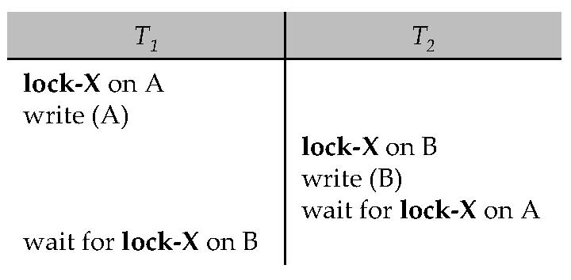
Deadlocks
Consider the following two transactions:
T₁: write (X) T₂: write(Y)
write(Y) write(X)
Schedule with deadlock

Slide 41
Recovery and Cascade Freedom
Problem with timestamp-ordering protocol:
Suppose T_{i} aborts, but T_{j} has read a data item written by T_{i}
Then T_{j} must abort; if T_{j} had been allowed to commit earlier, the schedule is not recoverable.
Further, any transaction that has read a data item written by T_{j} must abort
This can lead to cascading rollback --- that is, a chain of rollbacks
Solution 1:
A transaction is structured such that its writes are all performed at the end of its processing
A transaction that aborts is restarted with a new timestamp
Solution 2: Limited form of locking: wait for data to be committed before reading it
Solution 3: Use commit dependencies to ensure recovery

Slide 42
Thomas’ Write Rule
Modified version of the timestamp-ordering protocol in which obsolete write operations may be ignored under certain circumstances.
When T_{i} attempts to write data item Q, if TS(T_{i}) < W-timestamp(Q), then T_{i} is attempting to write an obsolete value of {Q}.
Rather than rolling back T_{i} as the timestamp ordering protocol would have done, this {write} operation can be ignored.
Otherwise this protocol is the same as the timestamp ordering protocol.
Thomas' Write Rule allows greater potential concurrency.
Allows some view-serializable schedules that are not conflict-serializable.

Slide 43
End of Module 16
Notes:
43

